Slide 1
Software Engineering and Architecture
SCM Versioning

Slide 2
Concepts I: Versioning
Theory of SCM

Slide 3
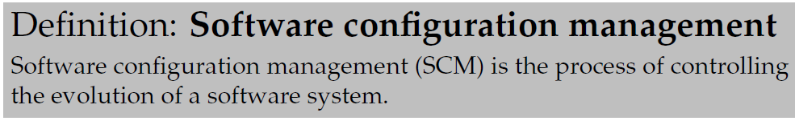
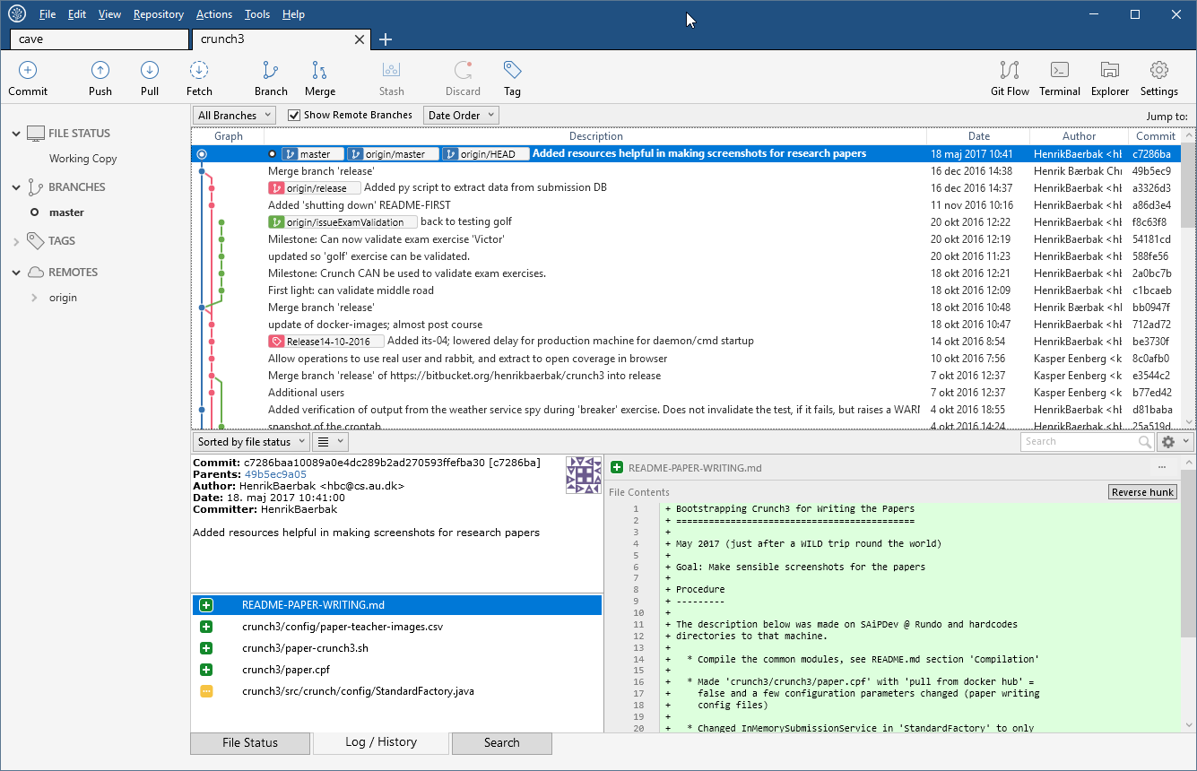
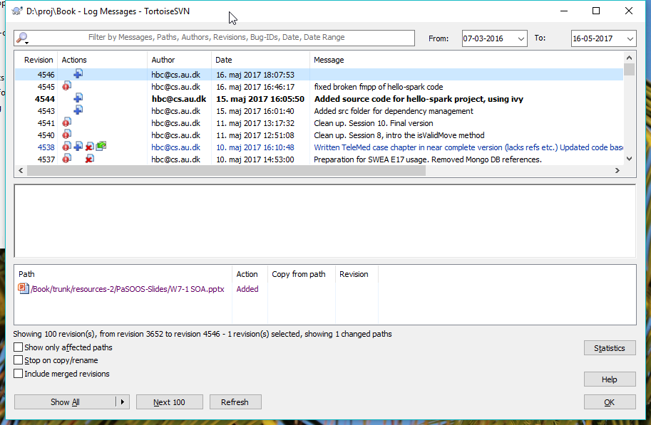
SCM

Slide 4
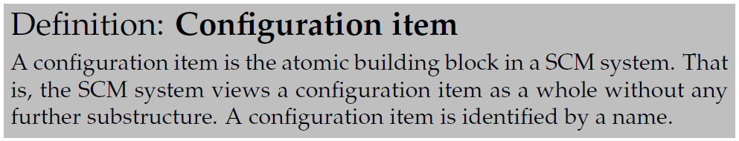
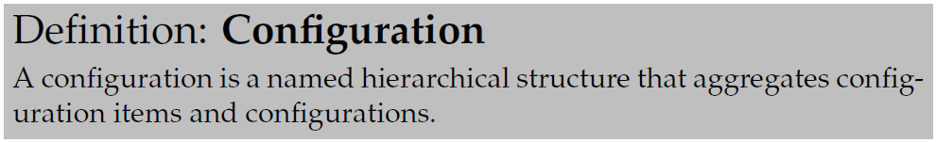
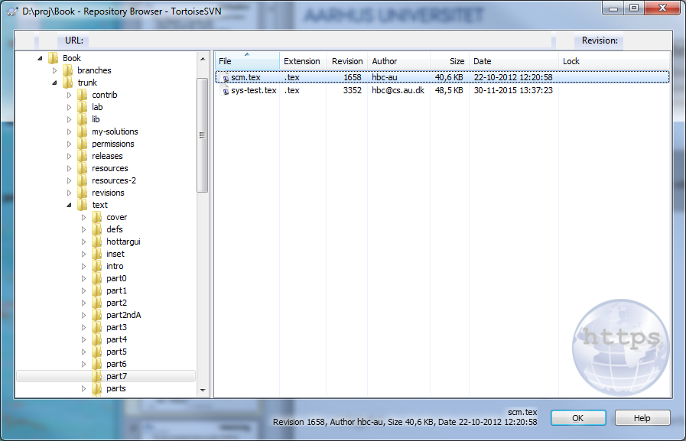
Configuration
Read: File
Think Composite Pattern
Git and SubVersion uses
  File = Configuration Item
  Folder = Configuration
Read: Folder

Slide 5
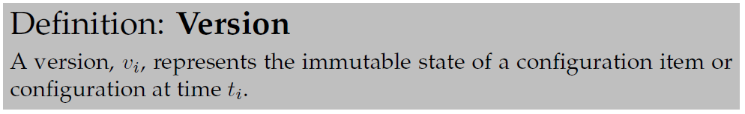
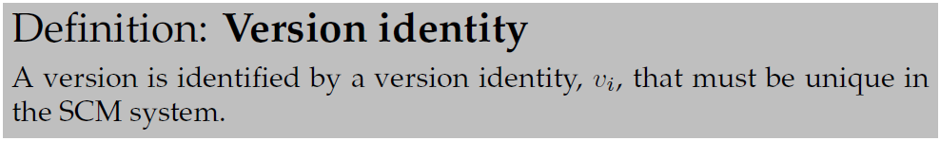
Versioning
The main purpose is to track evolution: time focus
Another term for SCM is Version Control
To give us a ‘handle’/’name’ of a version we need

Slide 6
Version Examples
SubVersion: Global Incrementing Integer
Git: Hashes/Fingerprints
Older systems: Dewey numbers (like: 4.3.2.2)

Slide 7
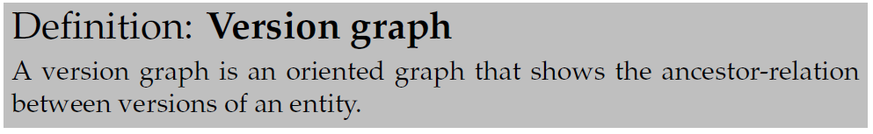
Evolution
Evolution is tracked over time
One advantage of integers/dewey over hashes
  Version 7 is before Version 8 and Version 21987
  Version 8 is after Version 3

Slide 8
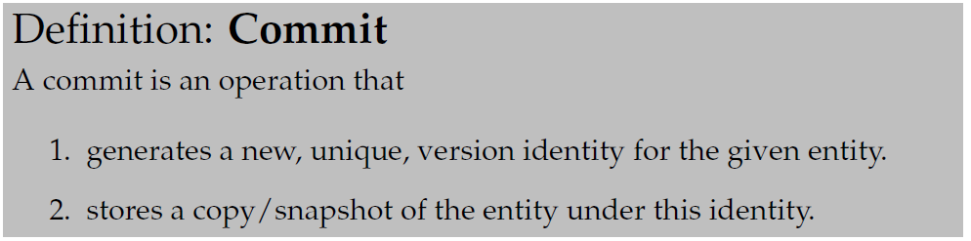
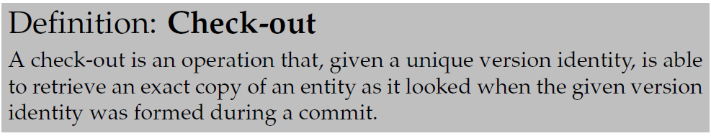
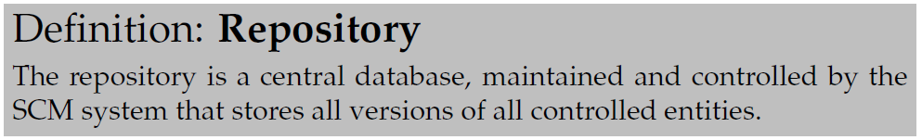
Check-in/Check-out
Operations
  Check-in / Commit: Snapshot in time to repository
  Check-out / Update: Snapshot in time from repository
Sigh! Git uses term ‘checkout’ for something completely different!
Note: Versions cannot be deleted!

Slide 9
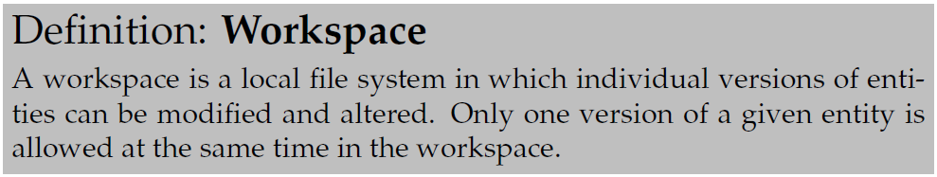
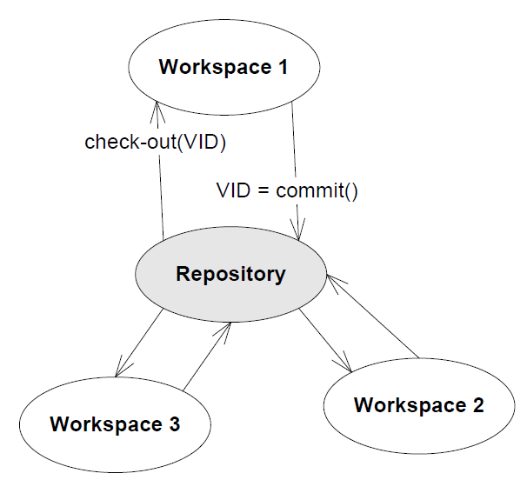
Workspace
Each developer has his/her own
workspace(s) in which modifications
are made
Repository is shared, collaboration
is handled through it…

Slide 10
So - Status
OK – what have we got?
  Versions made by commits into the repository; they form a version graph of identified versions that form a graph. This graph reflects the evolution over time.
  I can checkout any version into my workspace for review.
Basically version/release management
  I can reproduce the exact codebase as it looked when I gave it to the customer…
  if I
    a) remember to commit it and
    b) can remember the version identity

